Slide 1
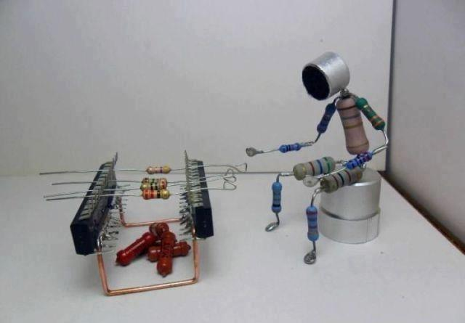
HOW TO DESIGN YOUR OWN CIRCUITS
-Made By: Anmol Ajay Saxena

Slide 2


Slide 3
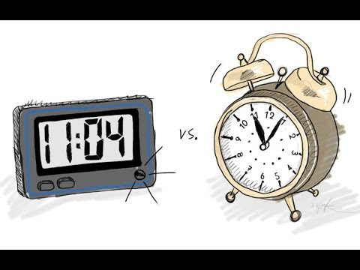

Slide 4


Slide 5

Analog
DIGITAL
ADC

Slide 6


Slide 7

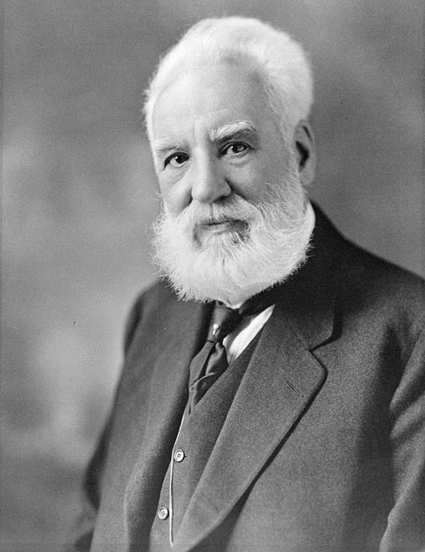
BELL LABS, NEW JERSEY
ALEXANDER GRAHAM BELL

Slide 8
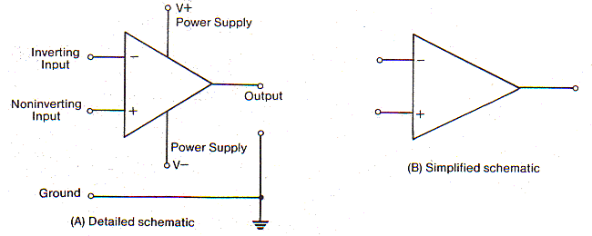
OP – AMP BASICS

Slide 9
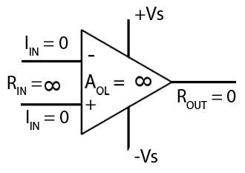
IDEAL OP AMP
Input impedance=Infinite
Output impedance = 0
Gain = Infinite
Bandwidth = infinite
Op amp neither sources nor
sinks current

Slide 10
CONFIGURATIONS OF OP - AMPS
NEGATIVE FEEDBACK
OPEN – LOOP CONFIGURATION
POSITIVE FEEDBACK

Slide 11
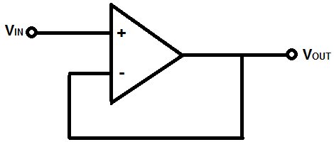
NEGATIVE FEEDBACK

Slide 12
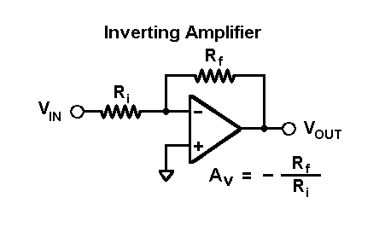
INVERTING AMPLIFIER CONFIGURATION

Slide 13
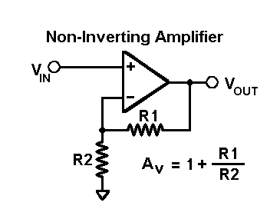
NON-INVERTING AMPLIFIER CONFIGURATION

Slide 14
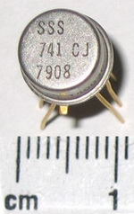
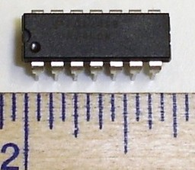
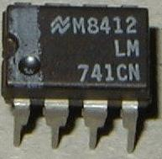
LM741

Slide 15
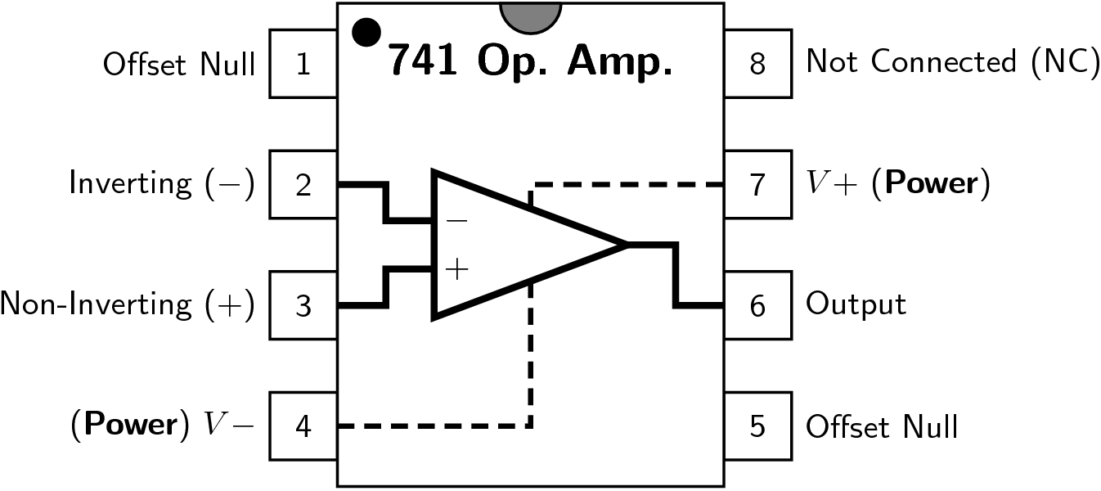
IC 741 – PIN OUT

Slide 16
WHAT DOES ‘741’ IN IC 741 STAND FOR?

Slide 17
LET’S OBSERVE WHY…

Slide 18
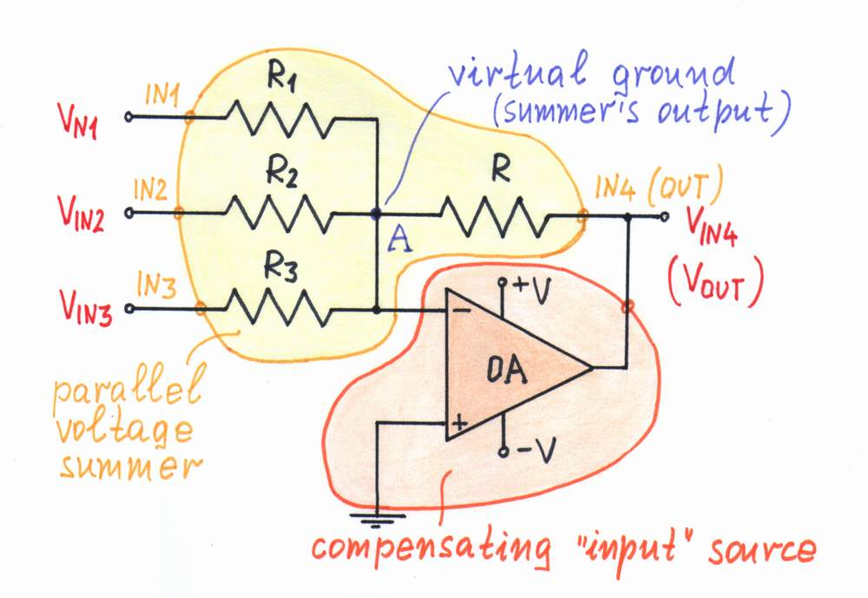
SUMMER CIRCUIT

Slide 19
WORKING MODEL LM741- ON HOLD

Slide 20
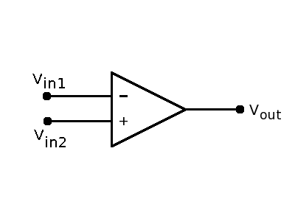
OPEN LOOP CONFIGURATION

Slide 21
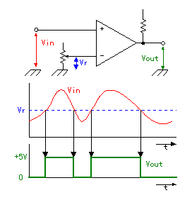
COMPARATOR

Slide 22
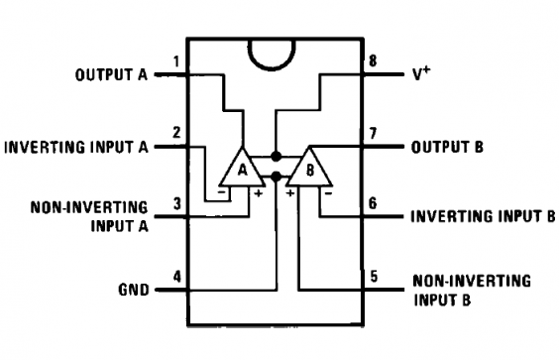
LM358 – PIN OUT

Slide 23
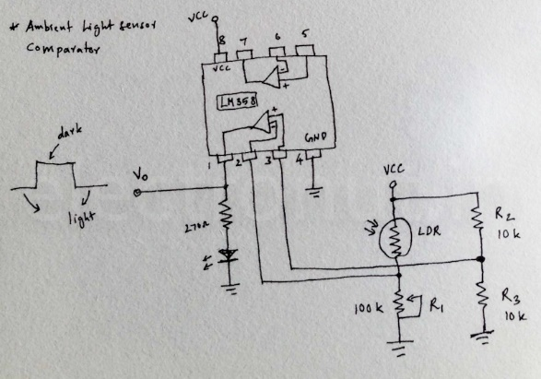

Slide 24
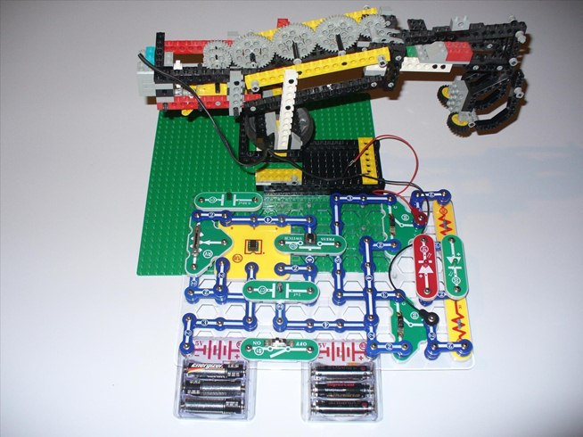


Slide 25


Slide 26
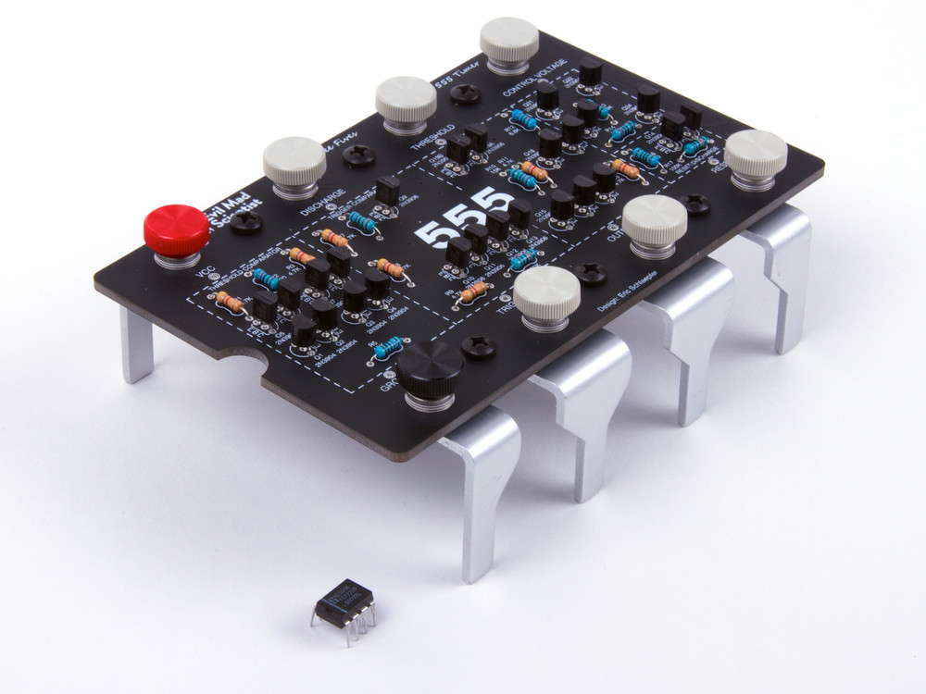
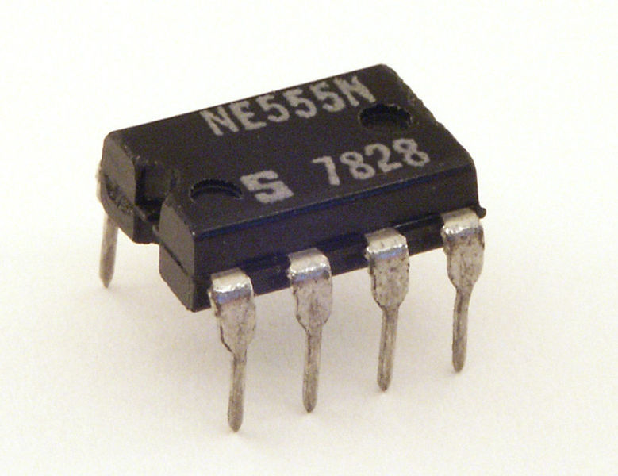

Slide 27
INTERNAL BLOCK DIAGRAM…
WHY SHOULD WE CARE ABOUT IT?

Slide 28
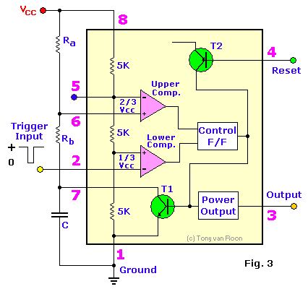

Slide 29
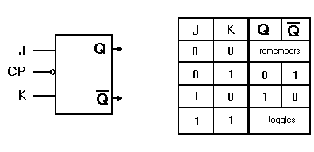

Slide 30
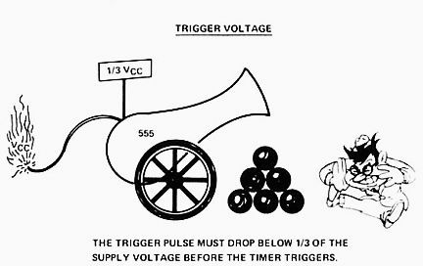
NEED FOR A TRIGGER

Slide 31
WHY 555?

Slide 32
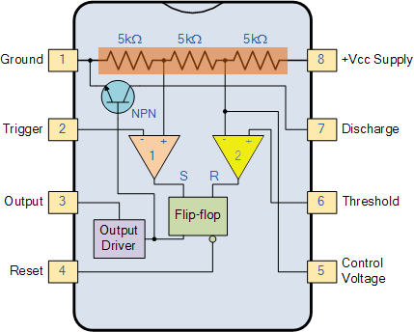
LET’S SEE WHY…

Slide 33
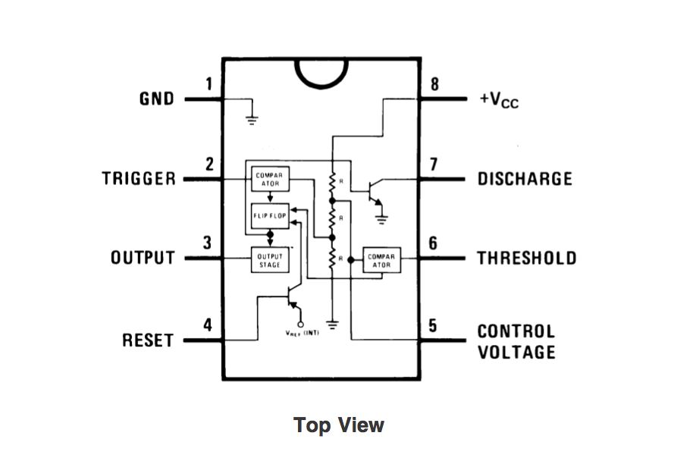
555 PIN OUT

Slide 34
3 MODES OF OPERATION
MONOSTABLE
ASTABLE
BISTABLE

Slide 35
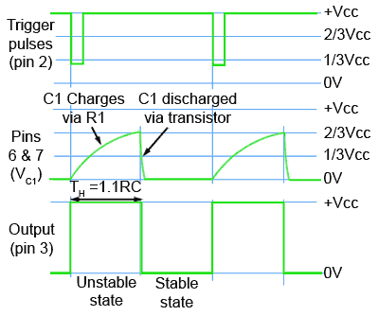
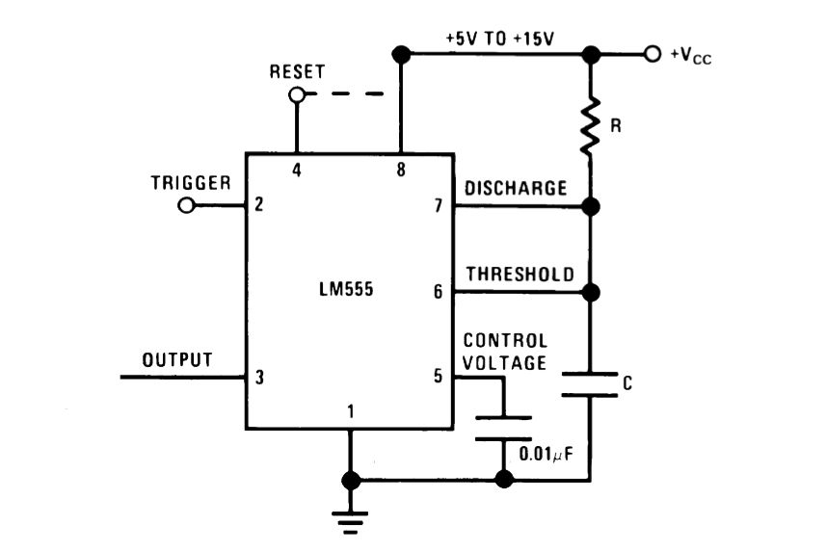
MONOSTABLE STATE

Slide 36
HOW COULD WE USE 555 IN MONOSTABLE STATE?

Slide 37
WORKING MODEL

Slide 38
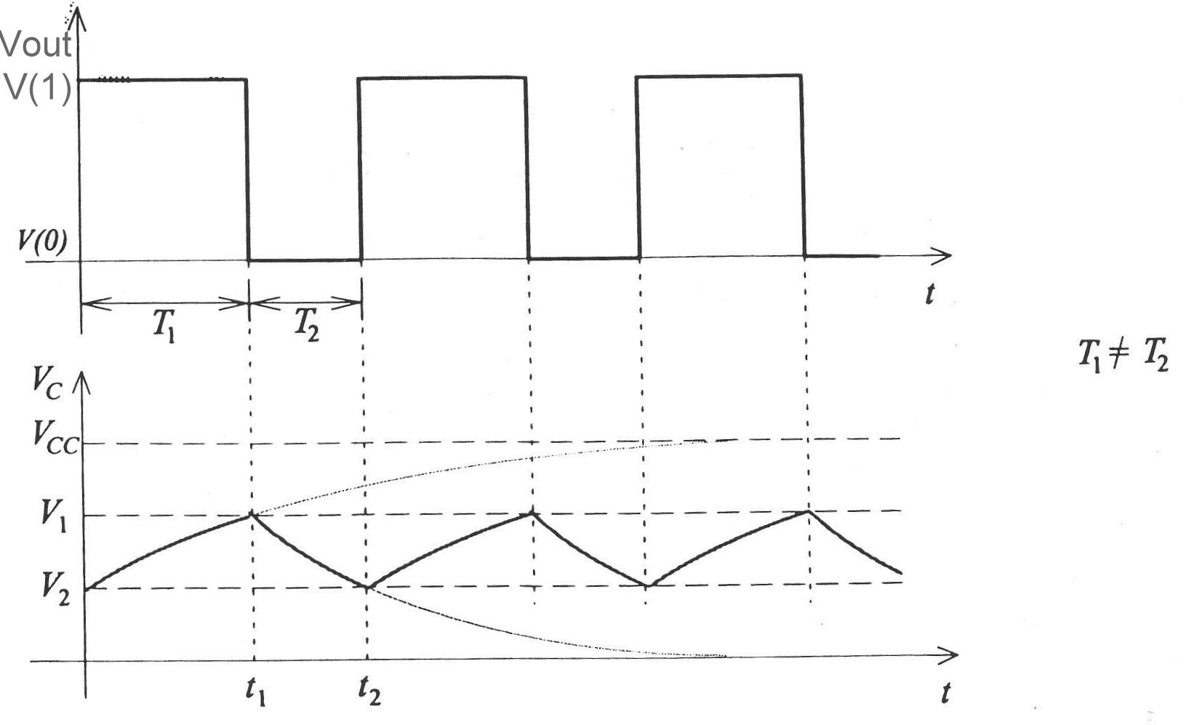
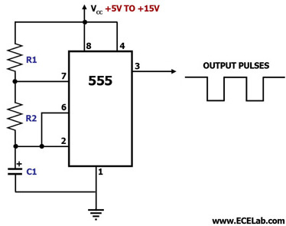
ASTABLE STATE

Slide 39
HOW CAN WE USE ASTABLE MODE OF OPERATION?

Slide 40
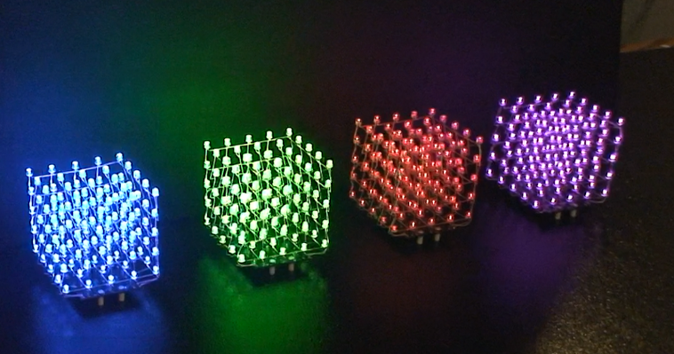

Slide 41
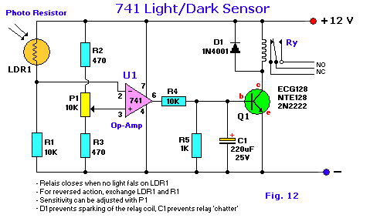
On hold….

Slide 42

THANK YOU! :D

